Slide 1
Clustering algorithms and cluster analysis

Slide 2
Supervised vs. Unsupervised Learning
Supervised learning (classification)
  Supervision: The training data (observations, measurements, etc.) are accompanied by labels indicating the class of the observations
  New data is classified based on the training set
Unsupervised learning (clustering)
  The class labels of training data is unknown
  In this we can predict the class labels by using clustering technique.

Slide 3

Supervised Technique

Slide 4
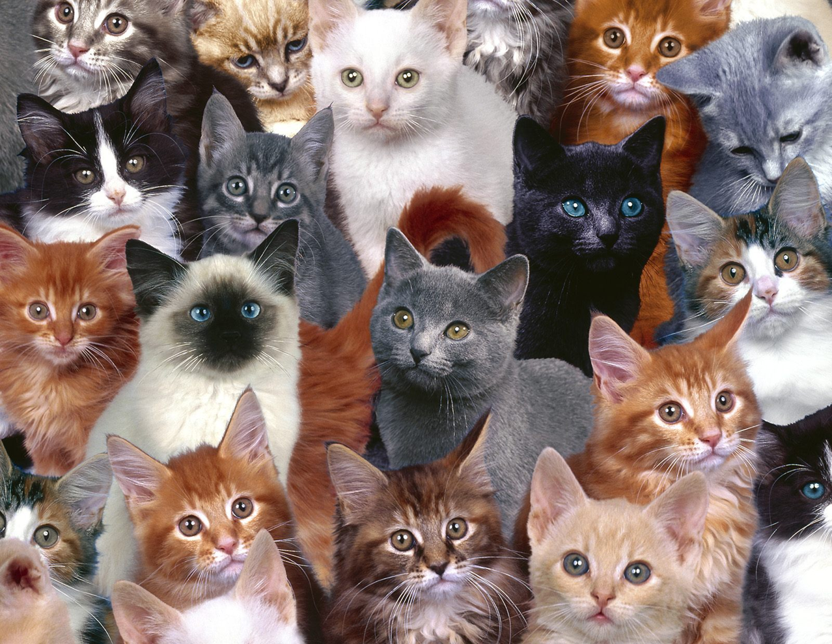
Unsupervised Technique

Slide 5
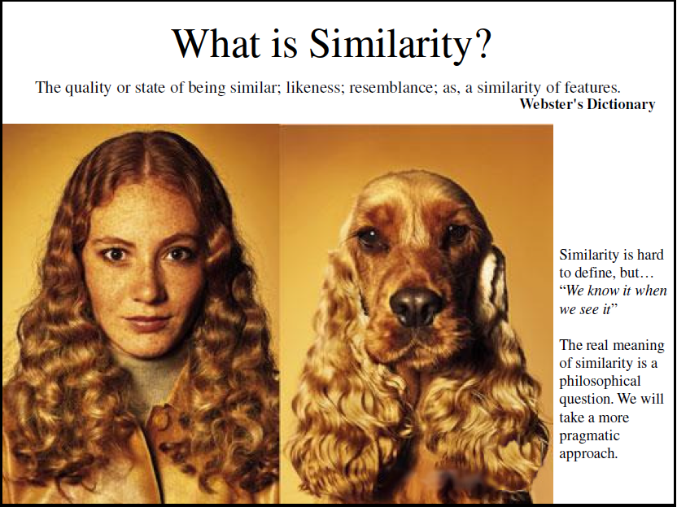

Slide 6
Similarity measure
is a numerical measure of how alike two data objects are.
higher when objects are more alike.
often falls in the range [0,1]
Similarity might be used to identify
duplicate data that may have differences due to typos.
equivalent instances from different data sets. E.g. names and/or
addresses that are the same but have misspellings.
groups of data that are very close (clusters)
Dissimilarity measure
is a numerical measure of how different two data objects are
lower when objects are more alike
minimum dissimilarity is often 0 while the upper limit varies depending on how much
variation can be
Dissimilarity might be used to identify
outliers
interesting exceptions, e.g. credit card fraud
boundaries to clusters
Proximity refers to either a similarity or dissimilarity

Slide 7
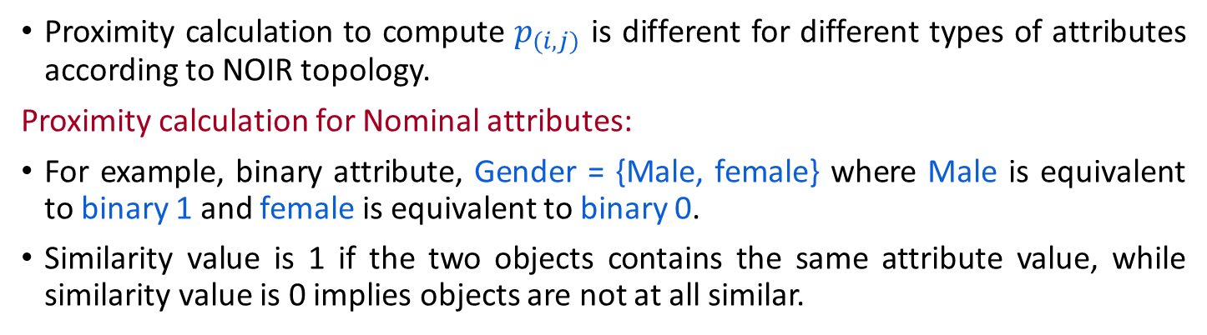
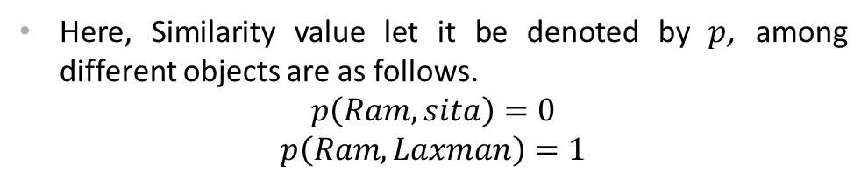
Proximity Calculation
Object | Gender
Ram | Male
Sita | Female
Laxman | Male

Slide 8
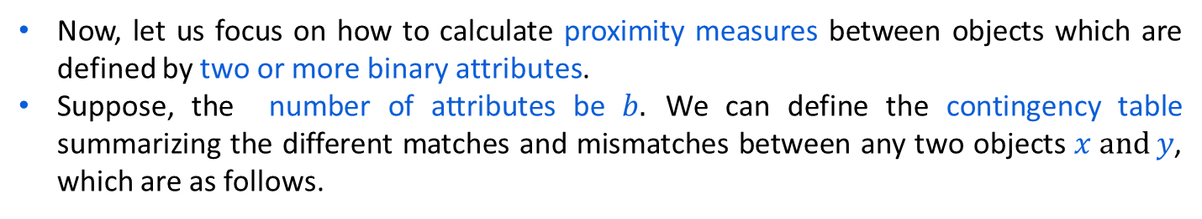
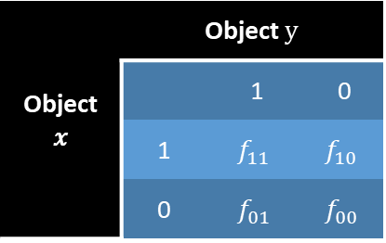
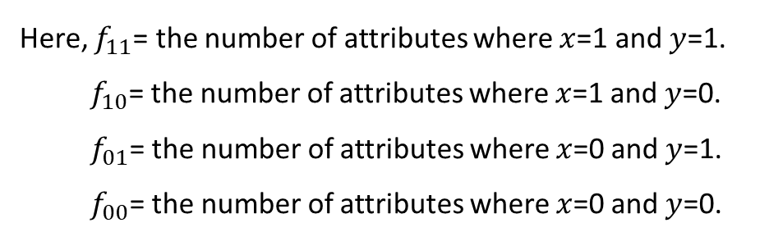
Proximity Calculation
Table 12.3: Contingency table with binary attributes

Slide 9
Similarity and Dissimilarity Measures
In clustering techniques, similarity (or dissimilarity) is an important measurement.
Informally, similarity between two objects (e.g., two images, two documents, two records, etc.) is a numerical measure of the degree to which two objects are alike.
The dissimilarity on the other hand, is another alternative (or opposite) measure of the degree to which two objects are different.
Both similarity and dissimilarity also termed as proximity.
Usually, similarity and dissimilarity are non-negative numbers and may range from zero (highly dissimilar (no similar)) to some finite/infinite value (highly similar (no dissimilar)).
Note:
Frequently, the term distance is used as a synonym for dissimilarity
In fact, it is used to refer as a special case of dissimilarity.

Slide 10
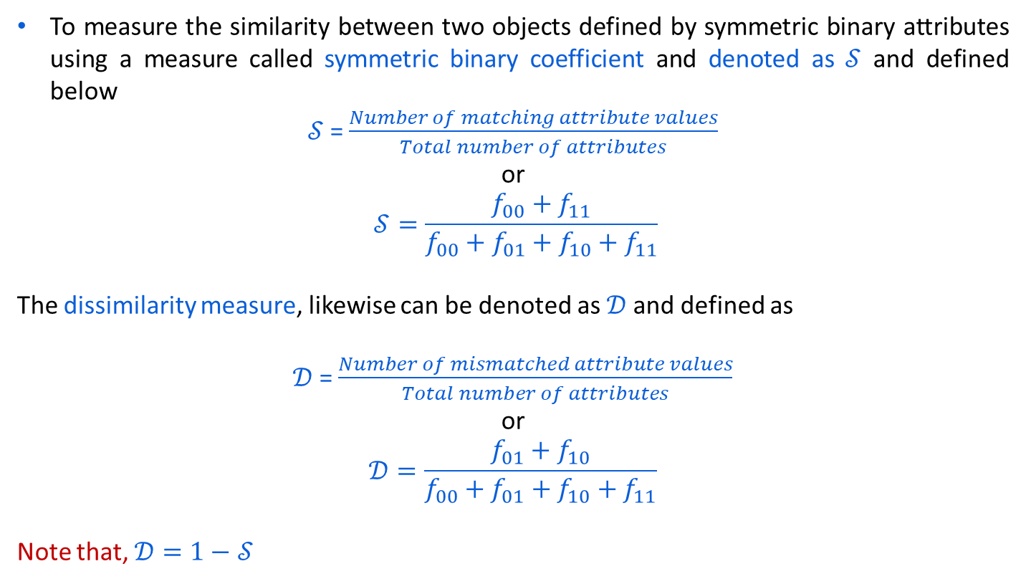
Similarity Measure with Symmetric Binary

Slide 11
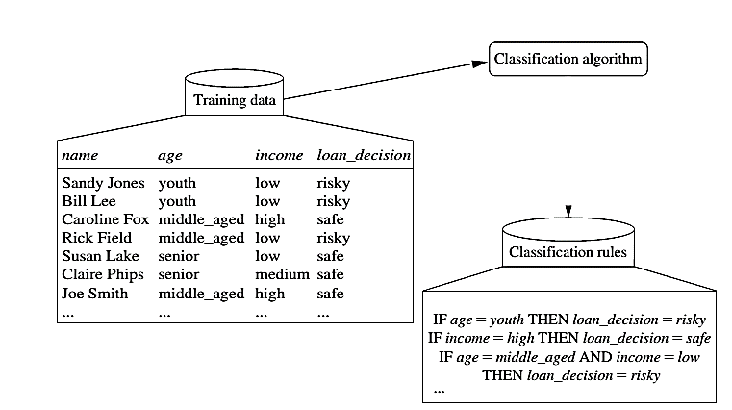
Classification Steps:
Learning

Slide 12
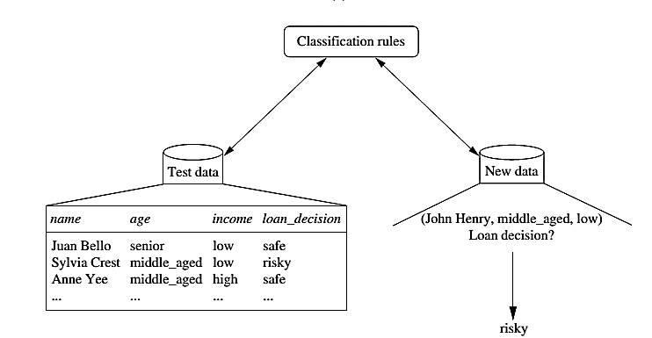
Classification

Slide 13



Process (1): Model Construction
Classification
Algorithms
Training
Data
Classifier
(Model)
IF rank = ‘professor’
OR years > 6
THEN tenured = ‘yes’

Slide 14


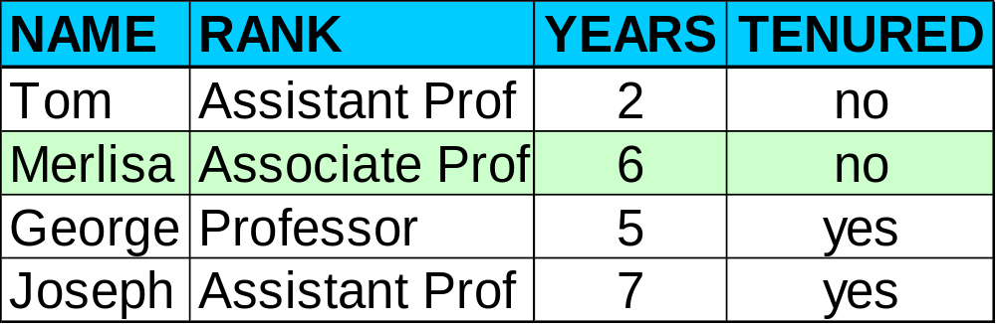

Process (2): Using the Model in Prediction
Classifier
Testing
Data
Unseen Data
(Jeff, Professor, 4)
Tenured?

Slide 15
K –MEANS ALGORITHM
Simplest unsupervised learning algorithms
Easy way to classify a given data set through number of cluster observations into groups of related observations
Complexity is O( n * K * I * d )
n = number of points, K = number of clusters,
I = number of iterations, d = number of attributes
Medical imaging, biometrics and related fields

Slide 16
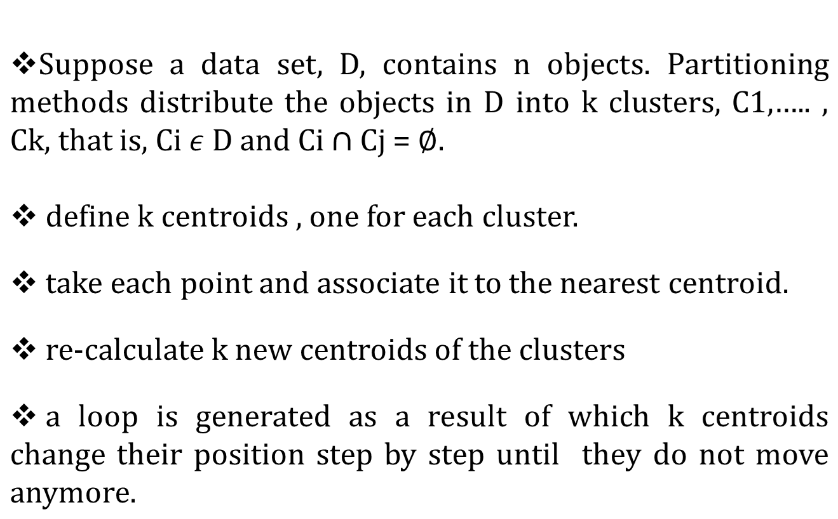
HOW IT WORKS ????

Slide 17



Finally this algorithm aims at minimizing an objective function
or
Where is choosen distance measure between data point
and the cluster centre is an indicator of the distance of n
data points from respective cluster centres.

Slide 18
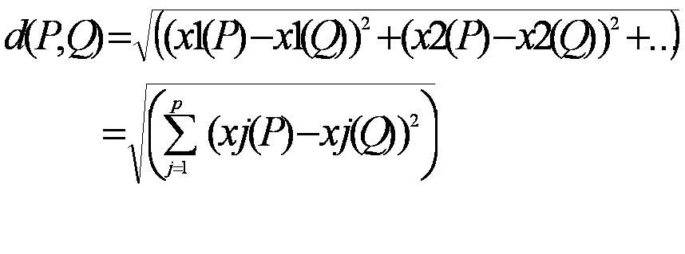
Let m_{i} be the mean of the vectors in cluster i
m_{i} is calculated randomly by using
    Euclidian metric: The commonly used distance measure is the Euclidean metric (mostly in case of multi-dimensional data)which defines the distance between two points
    P= ( x1(P), x2(P),…) and Q = ( x1(Q),x2(Q),…) is given by:

Slide 19
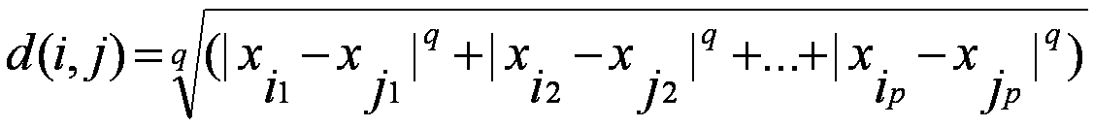

    Minskowski distance:
      where i = (x_{i1}, x_{i2}, …, x_{ip}) and j = (x_{j1}, x_{j2}, …, x_{jp}) are two p-dimensional data objects, and q is a positive integer
    Manhattan distance:
      If q = 1 , d gives the Manhattan distance

Slide 20
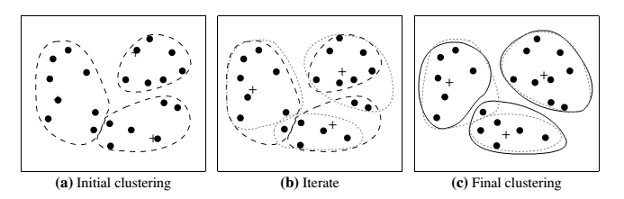
Example

Slide 21
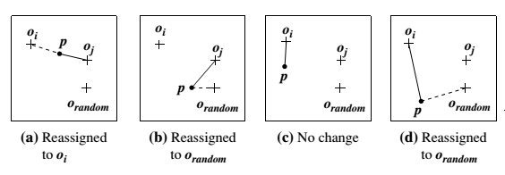
K--MEDOID CLUSTERING
The k-means algorithm is sensitive to outliers because such objects are far away from the majority of the data, and thus, when assigned to a cluster, they can dramatically distort the mean value of the cluster.
In this we choose one representative per cluster and rearrange the cluster objects.
Medoid basically means “least dissimilar object”(most similar).

Slide 22
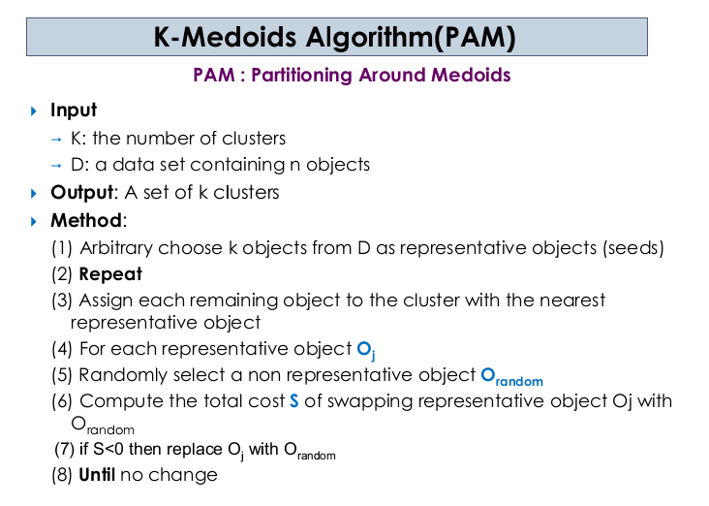

Slide 23
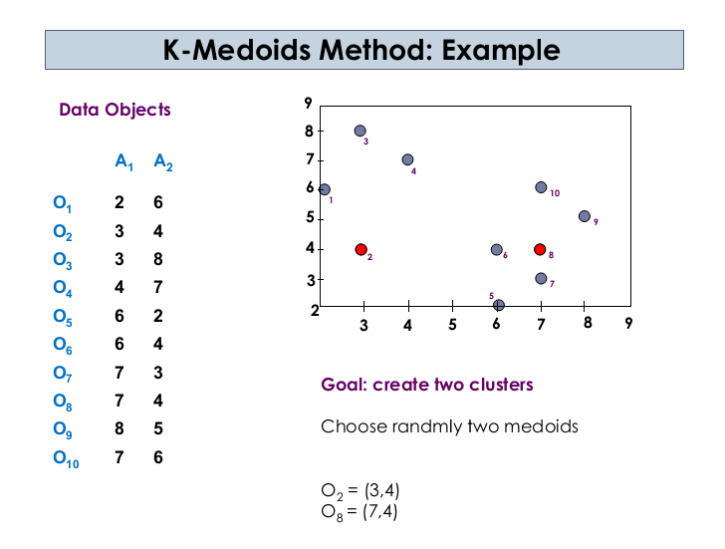

Slide 24
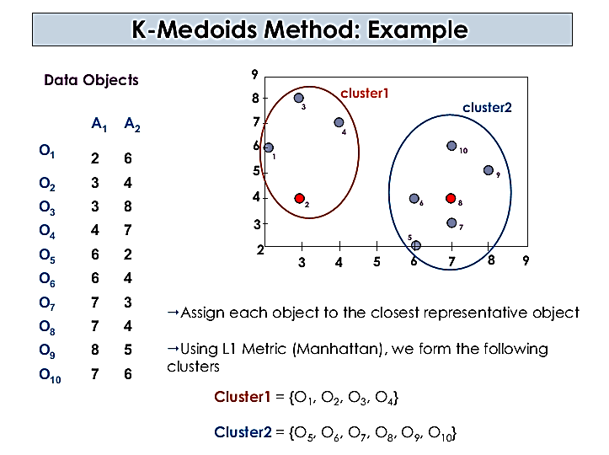

Slide 25
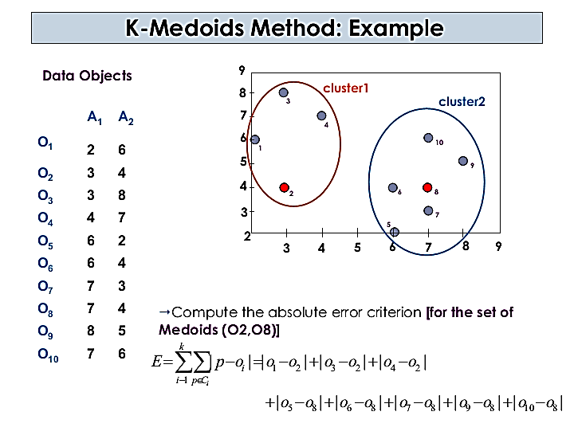

Slide 26
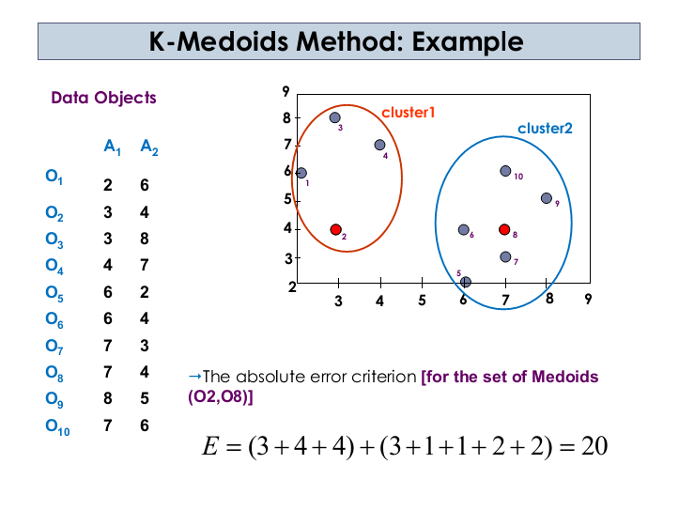

Slide 27
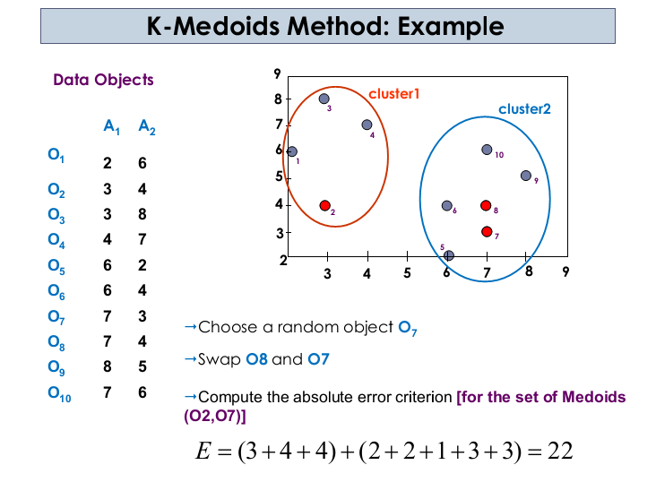

Slide 28
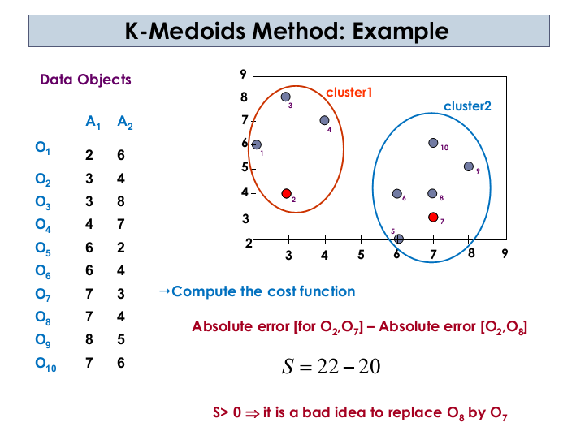

Slide 29
“Which method is more robust—k-means or k-medoids?”
The k-medoids method is more robust than k-means.
Because in the presence of noise and outliers medoid is less influenced by outliers or other extreme values than a mean.

Slide 30
Hierarchical Clustering
Use distance matrix as clustering criteria. This method does not require the number of clusters k as an input, but needs a termination condition
Step 0
Step 1
Step 2
Step 3
Step 4
agglomerative
(AGNES)
a
a b
b
a b c d e
c
c d e
d
d e
e
divisive
(DIANA)
Step 4
Step 3
Step 2
Step 1
Step 0

Slide 31
Hierarchical Clustering
Clusters are created in levels actually creating sets of clusters at each level.
Agglomerative
  Initially each item in its own cluster
  Iteratively clusters are merged together
  Bottom Up
Divisive
  Initially all items in one cluster
  Large clusters are successively divided
  Top Down

Slide 32
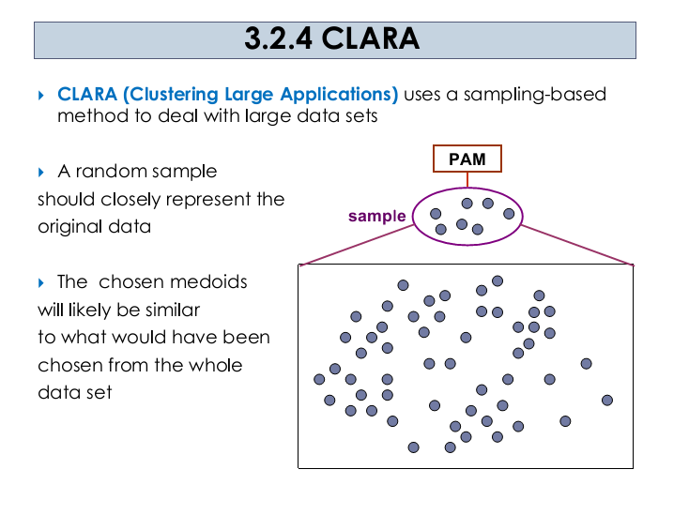

Slide 33
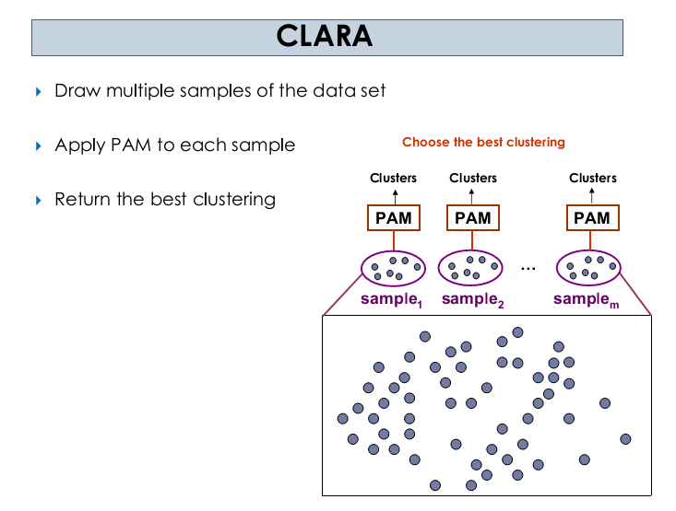
In many cases, a large sample works well if it is created so that each object has equal probability of being selected into the sample.
Notes:
PAM stands for “partition around medoids”.

Slide 34
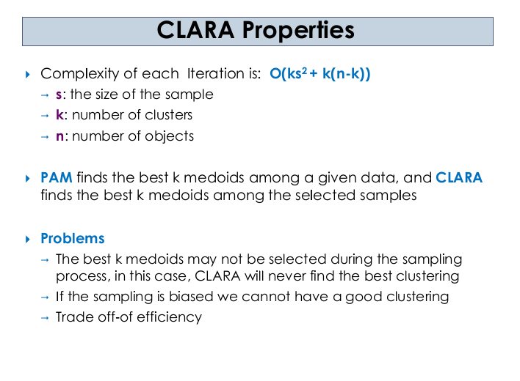

Slide 35
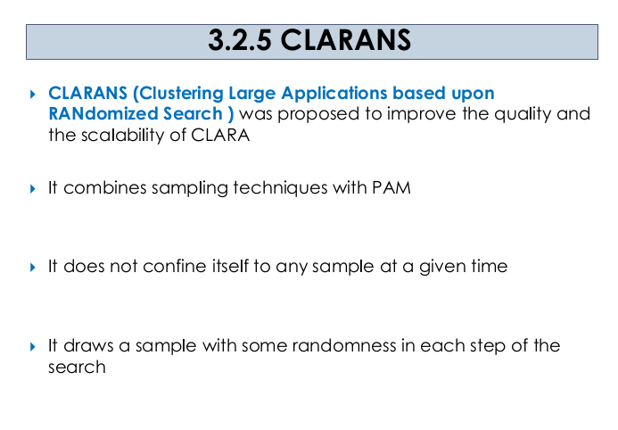
Notes:
PAM stands for “partition around medoids”.

Slide 36
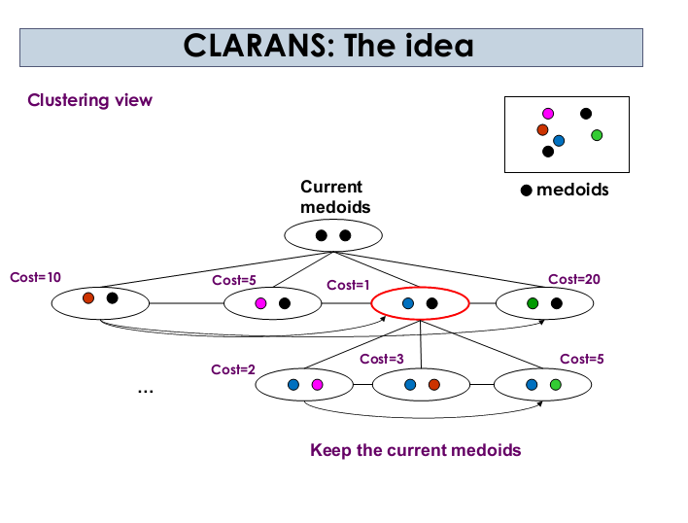

Slide 37
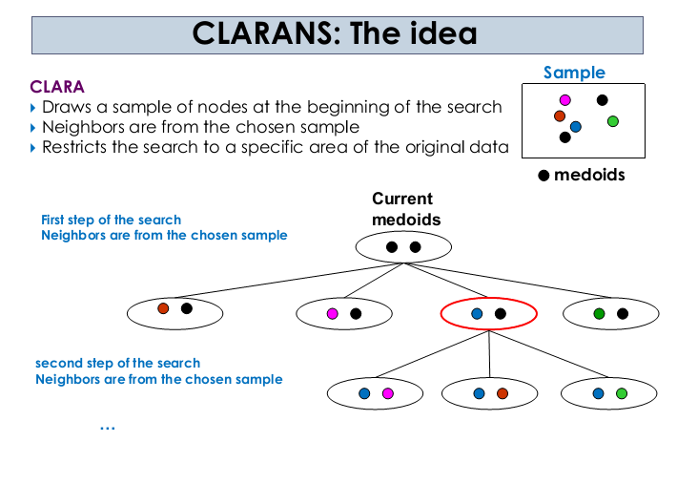

Slide 38
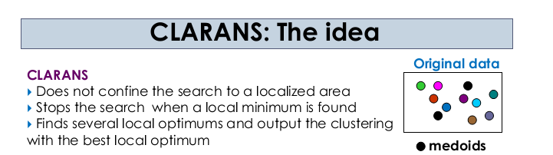

Slide 39
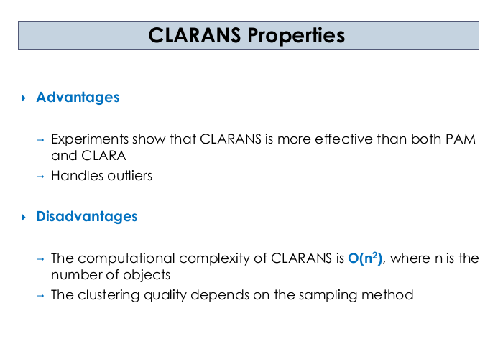

Slide 40
Data Warehousing – Tuning
As data warehousing is an emerging area, a lot of problems are found in the system. One of the major problems faced by the industry today is data warehouse maintenance.
Difficulties in Data Warehouse Tuning
The data warehouse never remain constant throughout the period of time.
It is very difficult to predict that what query the user is going to produce in future.
The need of the business also changes with time.
The users and their profile never remains the same with time.
The user can switch from one group to another.
the data load on the warehouse also changes with time.

Slide 41
Tuning Mechanisms
Performance Assessment
Here is the list of objective measures of performance.
Average query response time
Scan rates.
Time used per day query.
Memory usage per process.
I/O throughput rates
Data Load Tuning
Data Load is very critical part of processing.
Nothing else can run until data load is complete.
This is the entry point into the system.
Integrity Checks
The integrity checking highly affects the performance of the load

